Slide 1
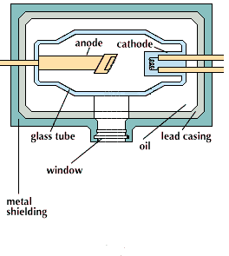
X-Ray Tube

Slide 2
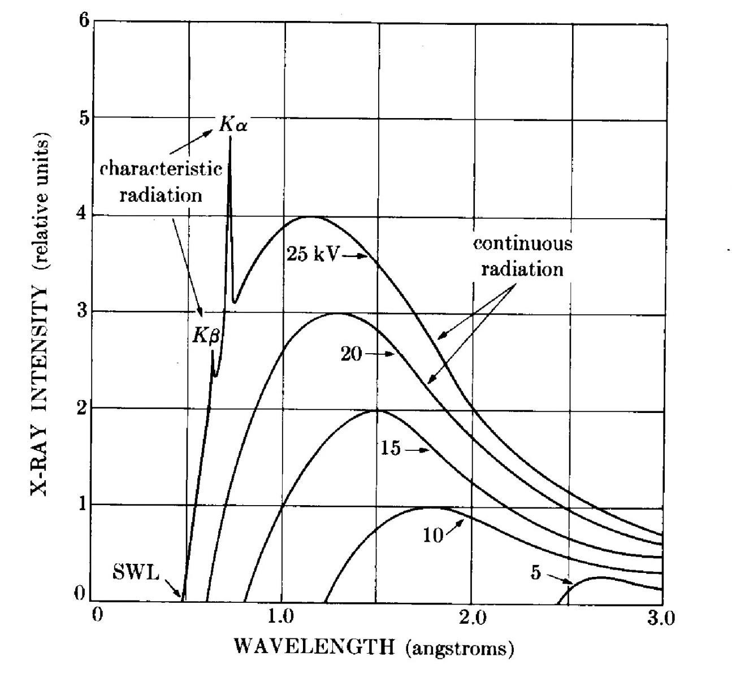
X-Ray Emission Spectra

Slide 3
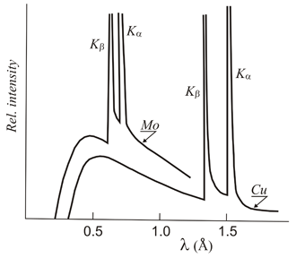
Each Material has its own unique set of X-Ray Emission Lines

